Slide 1
CSE332
Unit 6:- Ethical and Professional issues in Information Security

Slide 2
Ethical and Professional issues in Information Security
Cyber Crime ,Cyber-crime on the rise, Need for cyber law in India

Slide 3
Cyber crime
Cybercrime refers to any illegal activity that involves computers, networks, or digital devices.
These crimes are committed using technology to steal, manipulate, or destroy data, systems, or personal information.
Cybercrimes can target individuals, businesses, or even governments, leading to financial losses, security breaches, and privacy violations.

Slide 4
Types of Cyber Crimes
Cyber Fraud - Any fraudulent activity conducted online to deceive individuals or businesses for financial gain.
Hacking & Data Breaches - Gaining unauthorized access to computer systems or networks to steal, modify, or delete data.
Cyberbullying & Harassment - The use of digital platforms to harass, threaten, or abuse someone. This includes sending offensive messages, spreading false rumors, or sharing private photos without consent.

Slide 5
Intellectual Property Theft - The unauthorized use, reproduction, or distribution of copyrighted material, trademarks, or patented content.
Cyber Terrorism - The use of cyber attacks to disrupt critical infrastructures, government systems, or spread fear among the public.

Slide 6
Cyber-Crime on the Rise
Cybercrime has been increasing at an alarming rate worldwide.
With the rapid growth of digital transactions, cloud computing, and social media.
Cybercriminals have found new ways to exploit individuals, businesses, and governments.
The rise in cybercrime can be attributed to greater internet penetration, lack of cybersecurity awareness, and evolving hacking techniques.

Slide 7
Statistics and Reports on Rising Cybercrime
Cybercrime is expected to cost the world $10.5 trillion annually by 2025 (Cybersecurity Ventures report).
A cyberattack occurs every 39 seconds worldwide.
In 2023, more than 800 million ransomware attacks were reported globally.
Over 50,000 cybercrime cases were registered in India in 2023 (NCRB Data).

Slide 8
Major Reasons Behind the Rise in Cybercrime
Increased Digital Dependence
Lack of Cybersecurity Awareness
Advanced Hacking Techniques
Rise of Mobile & IoT Devices (43% of cyberattacks are now directed at mobile devices.)
Financial Motivation

Slide 9
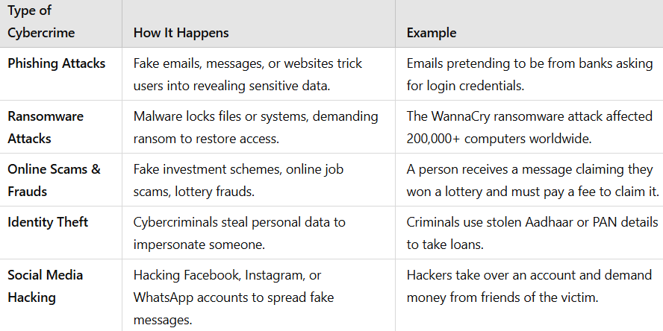

Slide 10
Need for Cyber Law in India
Cyber law refers to the legal framework that governs cybercrime, digital transactions, data protection, and online activities.
It defines the rights, responsibilities, and punishments related to crimes committed in cyberspace.

Slide 11
Objectives of Cyber Law:
✅ Prevent cybercrimes and punish offenders.
✅ Protect individuals, businesses, and government entities from cyber threats.
✅ Establish guidelines for e-commerce, digital payments, and IT security.
✅ Safeguard data privacy and prevent unauthorized access.
✅ Regulate electronic evidence in legal matters.

Slide 12
Key Cyber Laws in India
Information Technology (IT) Act, 2000
🔹 India’s primary cyber law that governs cybercrimes, digital transactions, and electronic evidence.
🔹 Covers: Hacking, identity theft, phishing, cyberstalking, and data protection.
🔹 Punishments: Up to 10 years of imprisonment and fines for serious cyber offenses.

Slide 13
Indian Penal Code (IPC) – Sections Related to Cybercrime
🔹 Section 419 & 420: Punishment for cheating and online fraud.
🔹 Section 500: Punishment for cyber defamation.
🔹 Section 354D: Covers cyberstalking and online harassment.

Slide 14
Digital Personal Data Protection (DPDP) Act, 2023
🔹 Protects personal data privacy and regulates how companies collect and use user information.
🔹 Ensures strict penalties for data breaches and misuse of private data.

Slide 15
National Cyber Security Policy, 2013
🔹 Strengthens India’s cybersecurity infrastructure.
🔹 Focuses on protecting critical sectors like banking, defense, and telecom.

Slide 16
Challenges in Implementing Cyber Laws
⚠ Lack of Awareness – Many people are unaware of cyber laws and their rights.
⚠ Jurisdiction Issues – Cybercrimes often involve multiple countries, making enforcement difficult.
⚠ Slow Legal Proceedings – Cybercrime cases take time to resolve due to technical complexities.
⚠ Cybercriminals Using Advanced Technologies – AI-powered malware and the dark web make it harder to track criminals.

